Slide 1
Advanced forensic methods & tools
Defense Against The Dark Arts
Christiaan Beek (@ChristiaanBeek)
IntelSecurity / McAfee Labs

Slide 2
Agenda
Day 1:
Learning Objectives
IR & Forensics Methods
Lab 1: Evidence acquisition with FTK Imager
Lab 2: Memory analysis with Volatility
Day 2:
Core Windows Forensic techniques
Windows Registry Primer
Lab 3:Timeline creation
File and directory analysis
Data recovery with Photorec
Lab 4: THE FINAL CHALLENGE

Slide 3
Learning objectives
How to best react to incidents while collecting volatile and non-volatile evidence
How to set up a forensic laboratory with state-of-the-art tools
How to investigate security breaches and analyse data without modifying it
How to create event timelines, recover data from unallocated space, extract evidence from the registry and how to parse windows event logs
How to analyze physical memory and extract artifacts from it

Slide 4

The forensic challenge
He knew something was wrong when he figured out there was an additional user account on the Web-based Application he administered.
He kept the system updated and patched, but he suspects that the system has been hacked…

Slide 5
Incident response & forensic methods
General principles and real case scenarios

Slide 6
Major case types
Fraud
Intellectual Property Theft
Hacker Intrusions / Data Breaches
Inappropriate Use of Internet
Child Exploitation
eDiscovery supporting:
Civil Litigation
Criminal Litigation

Slide 7
Forensics in a nutshell
“Forensic Computing is the process of identifying, preserving, analyzing and presenting digital evidence in a manner that is legally acceptable” (Rodney McKemmish 1999)
In simple words, it is the process of unearthing data of probative value from information systems
Can be broadly classified into three categories:
Live forensics
Post-mortem based forensics (memory/disk)
Network based forensics
Evidence acquisition
Investigation and analysis
Reporting results

Slide 8
Forensics in a nutshell
It includes the following aspects:
identify evidence
preserve evidence
analyze evidence
present results
This has to be done following the appropiate standards, especially if the results need to be admitted by a court of law
There are four principles you must always adhere to:
Minimize data loss
Record everything
Analyze all data collected (evidence)
Report findings

Slide 9
What is evidence
Evidence is anything you can use to prove or disprove a fact
In the context of computer forensics, evidence can be found at many different layers:
network (firewalls, IDS, routers...)
operating system
databases and applications
peripherals
removable media (CD/DVD, USB...)
and of course human testimony
Admissible evidence is evidence that a court accepts as legitimate

Slide 10
Evidence handling
You must preserve the integrity of the evidence at all times:
Creating a cryptographic hash of the entire disk and each partition (MD5 or SHA1)
Create bit-images copies and analyze them
Create a cryptographic hash of the copy and compare with the results obtained from the original. They MUST match!
Lock the original disk in a limited-access room or container
md5sum (Unix)
md= message digest
md5sum provides a 16 byte signature
In a post-mortem analysis, hash the evidence disk and individual partitions before doing anything else!
Hash the images to ensure they match
Example: to calculate the hash for a partition
md5sum /dev/sda1

Slide 11
LEGAL TOPICS FOR IR & FORENSIC ANALYSTS
LINKS TO FURTHER READING ON:
Chain of custody
Cybercrime law, etc…

Slide 12
The ir process
Incident Occurs Point-In-Time or Ongoing
Take Action
Legal Action
Administrative Action
Investigate the Incident
Incident Response Team Preparation
Incident Detection
Initial Response
Formulate Response Strategy
Data Collection
Forensic Analysis
Document Findings
Perform Non-Forensic Investigation
Remediation – Recover from the Incident
Evaluation

Slide 13
LEGAL TOPICS FOR IR & FORENSIC ANALYSTS
When dealing with digital evidence, ensuring that you have access and gather all the available evidence is paramount
Applications
OS
Server
Computerized Systems
Infrastructure Systems
LAN / DMZ
External Environment

Slide 14







Mapping evidence to an APT-case
Weaponization
Exploitation
Command and Control
Reconnaissance
Delivery
Installation
Actions on Objectives
Start
Step 1
Step 2
Step 3
Step 4
Step 5
Step 6
Step 7
Firewall / IPS logs
Email-Gateway-logs
Proxy-logs
Internet-History files
Java-IDX files
Windows Event Logs
Crash-dump files
$MFT
Memory-dump
Registry
Prefetch-files
Memory-dump
Firewall-logs
IPS-logs
Proxy-logs
Netflow
$MFT
Memory-dump
Registry
Prefetch-files
Netflow
Remote tools

Slide 15
THE INVESTIGATION CYCLE
Timeline Analysis
Media Analysis
String or Byte Search
Data Recovery
Reporting Analysis
Verification
System Description
Evidence Acquisition

Slide 16
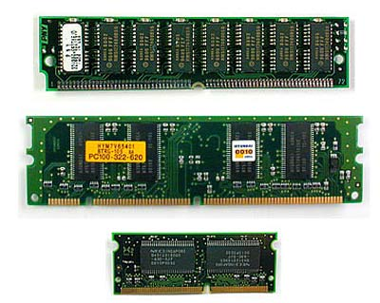
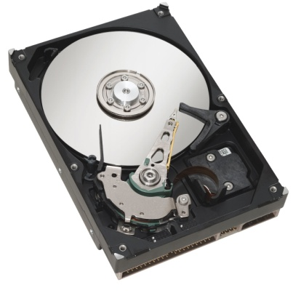

WHAT TO ACQUIRE
Memory:
Virtual and Physical
Drive:
Physical: entire drive
Logical: just a partition
Network traffic:
Full packet captures

Slide 17

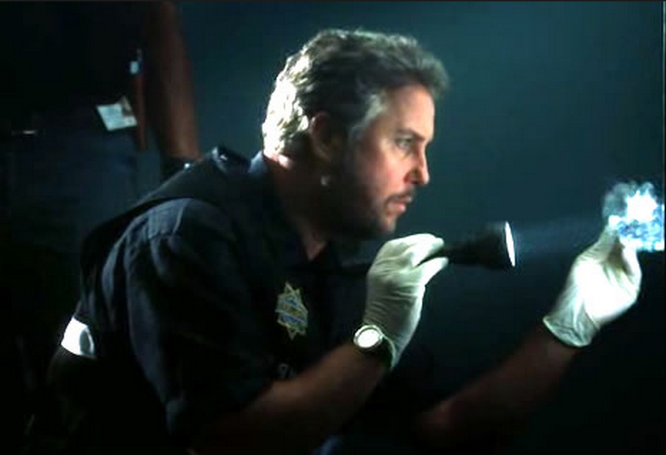
Locard’S EXCHANGE PRINCIPLE
States that when any two objects come into contact, there is always transference of material from each object onto the other
You cannot interact with a live system without having some effect on it

Slide 18

Locard’S EXCHANGE PRINCIPLE
Keep in mind when handling evidence:
“ONCE CONTAMINADED – STAY CONTAMINATED = COMPROMISED EVIDENCE”

Slide 19

INITIAL RESPONSE
Pull the plug or turn the machine off??
Powering down the suspect system can destroy critical evidence (in Windows, you may be able to recover certain data in pagefile.sys)
Attackers take advantage of the volatile storage media
The level to which one can hide data relies on the level of access to the system and the technical competency of the attacker.

Slide 20
ORDER OF VOLATILITY
When collecting evidence you should proceed from the volatile to the less volatile (see RFC 3227)
Here is an example order of volatility for a typical system:
System Memory
Temporary File Systems (swapfile / paging file)
Process Table & Network Connections
Specific Process Information May Be Dumped
Network Routing Information & ARP Cache
Forensics Acquisition of Disks
Remote Logging & Monitoring Data
Physical configuration & network topology
Backups

Slide 21
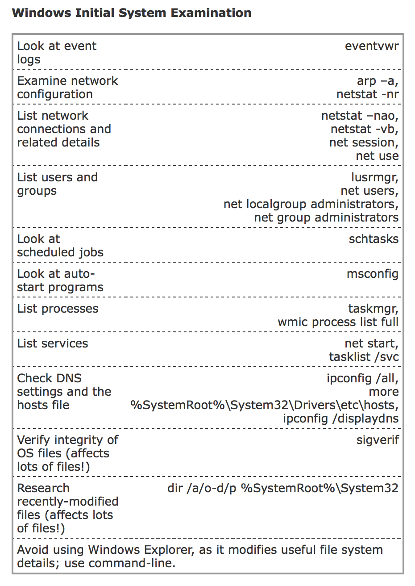
lIVE RESPONSE ON WINDOWS
Obtain the volatile data
All data that will be lost upon shutdown
Obtain the non-volatile data
Time / Date stamps
Event logs
Web / Application logs
Registry (if applicable)
Obtain any relevant, logical files
Unknown executables
Attacker tools
Any file relating to the incident that is not covered under volatile or non-volatile data

Slide 22
Lab 1: hANDS ON evidence acquisition
Acquiring volatile and non-volatile evidence with FTK Imager

Slide 23
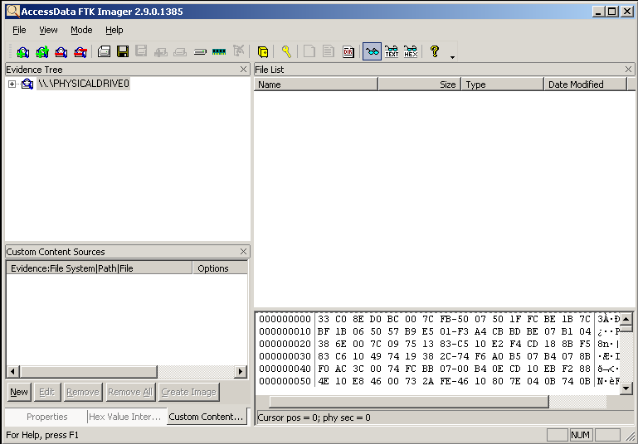
FTK Imager
Walk through step by step acquisition…

Slide 24
Memory analysis
An introduction to memory analysis with Volatility

Slide 25
Physical memory
Physical memory is the short-term memory of a computer (aka RAM)
Rapid decay of information as soon as memory module is disconnected from power and clock sources.
Although as recent studies have proven, not as rapid a decay as we may have initially believed…
Why would you like to dump the contents of RAM?
There is a wealth of information in RAM that exists only when applications are running. Most of this information cannot easily be obtained from a hard drive
Analyzing the content of RAM you can find artifacts ‘hidden’ by the attackers
You can even find information about processes that have exited

Slide 26
What can be obtained from memory?
All running processes at the time of the memory snapshot
All loaded modules and DLL’s (dynamic link libraries) including injected malware
All running device drivers, including potential rootkits
All open files for each process, including path to file on disk
All open registry keys for each process
All open network sockets for each process, including IP address and port information
Decrypted versions of otherwise encrypted data
Contents of windows
Keystrokes
Email attachments, file transfers, and other “secondary” data
Cryptographic key material
Hard‐drive encryption keys
WEP and WPA wireless keys
Usernames and passwords

Slide 27
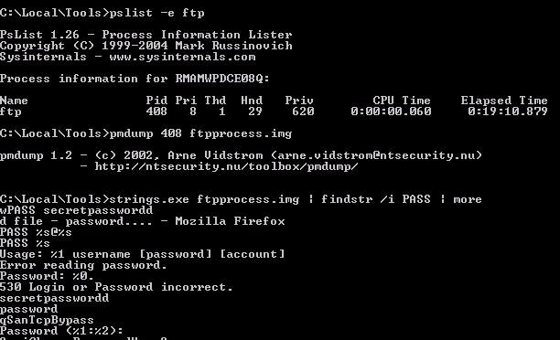
SHOW ME YOUR PASSWORDS!

Slide 28
VIRTUAL MEMORY
Every process within Windows is assigned 4GiB of Virtual Memory, split into halves
Application 2 GiB
System 2 GiB
4 GiB
4 GiB

Slide 29
PHYSICAL MEMORY
Physical memory is divided into so called “pages” and allocated virtual memory is mapped onto physical memory page by page
The same page of physical memory can appear at different locations within the same address space or in different address spaces
Data can be moved from physical memory into a page file to clear some space
Memory does not get over written when it is marked as free

Slide 30
ANALYZING MEMORY DUMPS
Different methods to enumerate information
Look for a printable string
Reconstruct internal data structures
Search for static signatures of kernel data structures

Slide 31
Strings – ‘old skool’
Sysinternals’ strings - defaults to Unicode and ASCII, minimum length 3 characters
No context, difficult to interpret
What string is associated with which program, etc.
A lot of interesting information is not in a printable format
Timestamps (FILETIME, uint32)
IP Addresses

Slide 32
Volatility & yara
Volatility
Advanced memory forensics framework
Python
Write & create your own plugins
Lot of useful plugins for malware detection
Awesome (!!) free tool
Yara
Malware plugins for Volatility
Easy to write custom extensions
Volatility – plugin examples
Malfind: detects hidden and injected code
Csrpslist: detects hidden processes with crss.exe handles & CsrRoot-Process links
Orphan threads: detects hidden kernel threads
PSList: shows processes based on linked lists
PSScan: shows processes based on the headers found in the “memory pool”

Slide 33
VOLATILITY
Malware related Volatility plugins:
malfind
svcscan
ldrmodules
impscan
apihooks
idt
gdt
orphanthreads
callbacks
driverirp
psxview
ssdt_ex
ssdt_by_threads

Slide 34
Lab 2: MEMORY ANALYSIS WITH VOLATILITY
Analyzing a sample memory dump with Volatility
Notes:
https://github.com/volatilityfoundation/volatility/wiki/Memory-Samples
https://code.google.com/p/volatility/wiki/CommandReference

Slide 35
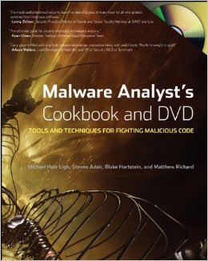
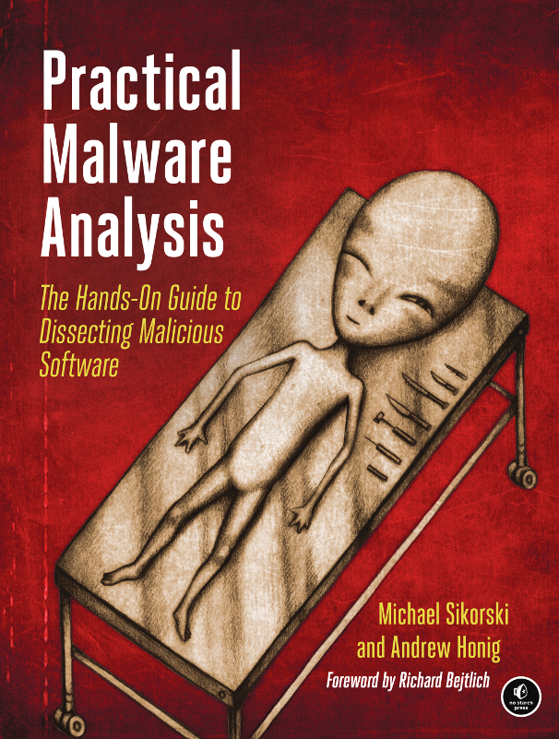
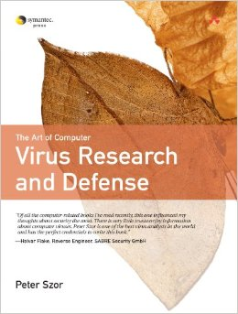
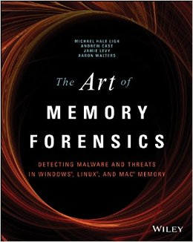
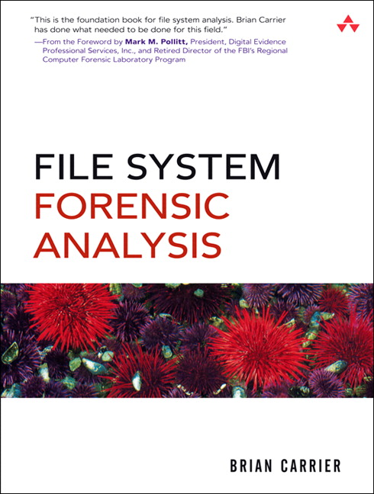
Memory analysis with volatility
Walk through the exercise…
https://github.com/volatilityfoundation/volatility/wiki/Memory-Samples
https://code.google.com/p/volatility/wiki/CommandReference
http://www.dfrws.org/2007/proceedings/p62-dolan-gavitt.pdf - vadtree

